Slide 1
Distributed Objects

Slide 2
Message Passing versus Distributed Objects
The message-passing paradigm is a natural model for distributed computing, in the sense that it mimics inter-human communications.
It is an appropriate paradigm for network services where processes interact with each other through the exchanges of messages.
However, the abstraction provided by this paradigm does not meet the needs of the complexity of sophisticated network applications.

Slide 3
Message Passing Paradigm
Message passing requires the participating processes to be tightly-coupled: throughout their interaction, the processes must be in direct communication with each other.
If communication is lost between the processes (due to failures in the communication link, in the systems, or in one of the processes), the collaboration fails.
The message-passing paradigm is data-oriented.
Each message contains data marshalled in a mutually agreed upon format and is interpreted as a request or response according to the protocol.
The receiving of each message triggers an action in the receiving process.
It is inadequate for complex applications involving a large mix of requests and responses.
In such an application, the task of interpreting the messages can become overwhelming.

Slide 4
The distributed object paradigm
provides abstractions beyond those of the message-passing model.
In object-oriented programming, objects are used to represent an entity significant to an application.
Each object encapsulates:
the state or data of the entity: in Java, such data is contained in the instance variables of each object;
the operations of the entity, through which the state of the entity can be accessed or updated.

Slide 5
Local Objects vs. Distributed Objects
Local objects are those whose methods can only be invoked by a local process, a process that runs on the same computer on which the object exists.
A distributed object is one whose methods can be invoked by a remote process, a process running on a computer connected via a network to the computer on which the object exists.

Slide 6
The Distributed Object Paradigm
In a distributed object paradigm, network resources are represented by distributed objects.
To request service from a network resource, a process invokes one of its operations or methods, passing data as parameters to the method.
The method is executed on the remote host, and the response is sent back to the requesting process as a return value.

Slide 7
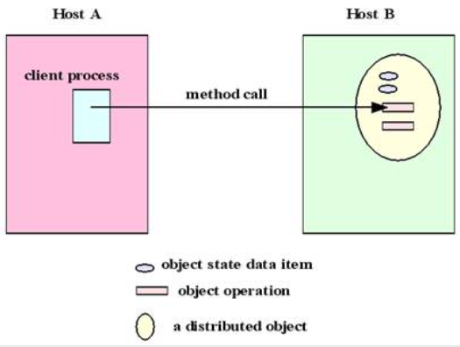
The Distributed Object Paradigm

Slide 8
Message-passing paradigm vs Distributed objects paradigm
Message-passing paradigm => data-oriented,
Distributed objects paradigm => action-oriented:
the focus is on the invocation of the operations, while the data passed takes on a secondary role.
Although less intuitive to human-beings, the distributed-object paradigm is more natural to object-oriented software development.

Slide 9
Distributed Object Systems/Protocols
The distributed object paradigm has been widely adopted in distributed applications, for which a large number of mechanisms based on the paradigm are available.
Among the most well known of such mechanisms are:
Java Remote Method Invocation (RMI),
the Common Object Request Broker Architecture (CORBA) systems,
the Distributed Component Object Model (DCOM),
mechanisms that support the Simple Object Access Protocol (SOAP).
Of these, the most straightforward is the Java RMI

Slide 10
From Remote Procedure Call to Remote Method Invocation
Remote Procedure Calls (RPC) – 1
Remote Method Invocation has its origin in a paradigm called Remote Procedure Call
Remote procedure call model:
A procedure call is made by one process to another, with data passed as arguments.
Upon receiving a call:
the actions encoded in the procedure are executed,
the caller is notified of the completion of the call,
a return value, if any, is transmitted from the callee to the caller.

Slide 11
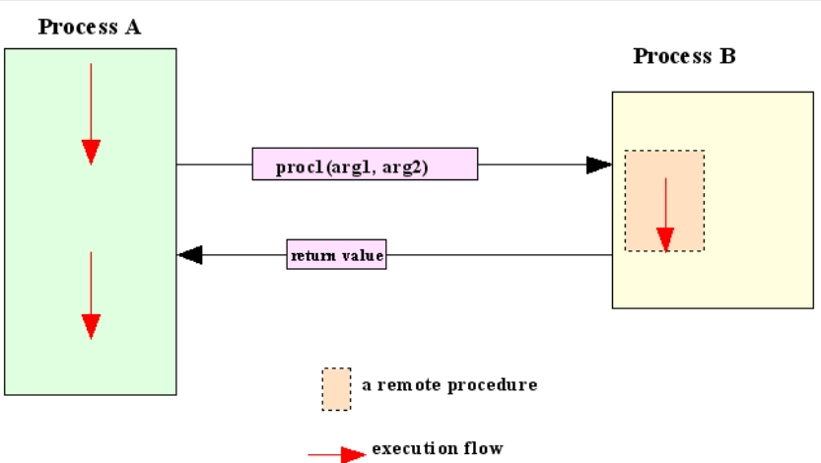
From Remote Procedure Call to Remote Method Invocation

Slide 12
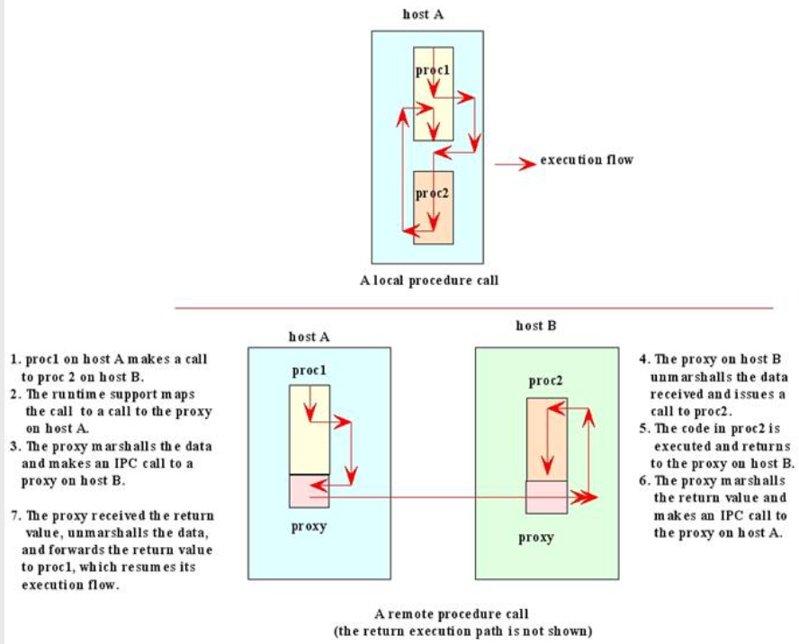

Slide 13
From Remote Procedure Call to Remote Method Invocation
Remote Procedure Calls (RPC) – 2
Since its introduction in the early 1980s, the Remote Procedure Call model has been widely in use in network applications.
There are two prevalent APIs for this paradigm.
the Open Network Computing Remote Procedure Call, evolved from the RPC API originated from Sun Microsystems in the early 1980s.
The other well-known API is the Open Group Distributed Computing Environment (DCE) RPC.
Both APIs provide a tool, rpcgen, for transforming remote procedure calls to local procedure calls to the stub.

Slide 14
Java Remote Method Invocation
Remote Method Invocation
Remote Method Invocation (RMI) is an object-oriented implementation of the Remote Procedure Call model.
It is an API for Java programs only.
Using RMI, an object server exports a remote object and registers it with a directory service.
The object provides remote methods, which can be invoked in client programs.
Syntactically:
A remote object is declared with a remote interface, an extension of the Java interface.
The remote interface is implemented by the object server.
An object client accesses the object by invoking the remote methods associated with the objects using syntax provided for remote method invocations.

Slide 15
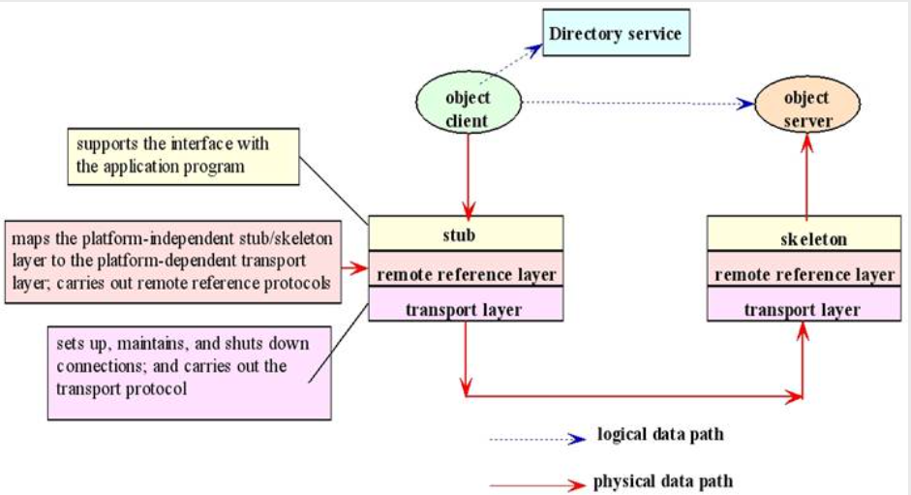
The Java RMI Architecture

Slide 16
Object Registry
The RMI API allows a number of directory services to be used for registering a distributed object.
A simple directory service called the RMI registry, rmiregistry, which is provided with the Java Software Development Kit
The RMI Registry is a service whose server, when active, runs on the object server’s host machine, by convention and by default on the TCP port 1099.

Slide 17
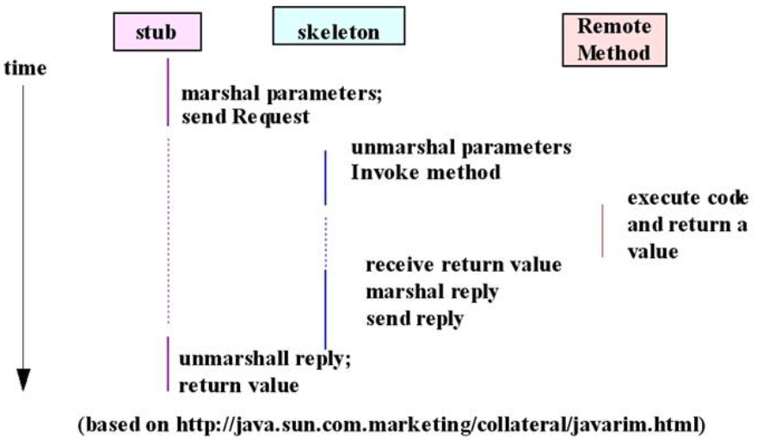
The interaction between the stub and the skeleton
A time-event diagram describing the interaction between the stub and the skeleton:

Slide 18
The API for the Java RMI
The Remote Interface
The Server-side Software
The Remote Interface Implementation
Stub and Skeleton Generations
The Object Server
The Client-side Software

Slide 19
The Remote Interface
A Java interface is a class that serves as a template for other classes:
it contains declarations or signatures of methods[1] whose implementations are to be supplied by classes that implements the interface.
A java remote interface is an interface that inherits from the Java Remote class, which allows the interface to be implemented using RMI syntax.
Other than the Remote extension and the Remote exception that must be specified with each method signature, a remote interface has the same syntax as a regular or local Java interface.

Slide 20
The Remote Interface
The java.rmi.Remote Exception must be listed in the throw clause of each method signature.
This exception is raised when errors occur during the processing of a remote method call, and the exception is required to be caught in the method caller’s program.
Causes of such exceptions include exceptions that may occur during interprocess communications, such as access failures and connection failures, as well as problems unique to remote method invocations, including errors resulting from the object, the stub, or the skeleton not being found.

Slide 21
The Server-side Software
An object server is an object that provides the methods of and the interface to a distributed object.
Each object server must
implement each of the remote methods specified in the interface,
register an object which contains the implementation with a directory service.
It is recommended that the two parts be provided as separate classes.

Slide 22
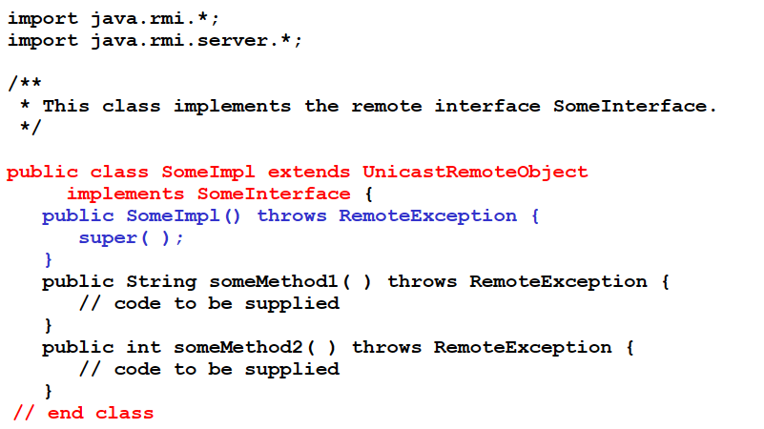
The Remote Interface Implementation
A class which implements the remote interface should be provided.
The syntax is similar to a class that implements a local interface.

Slide 23
Stub and Skeleton Generations
In RMI, each distributed object requires a proxy each for the object server and the object client, knowns as the object’s skeleton and stub respectively.
These proxies are generated from the implementation of a remote interface using a tool provided with the Java SDK:
the RMI compiler rmic.
rmic <class name of the remote interface implementation>
For example:
rmic SomeImpl
As a result of the compilation, two proxy files will be generated, each prefixed with the implementation class name:
SomeImpl_skel.class
SomeImpl_stub.class

Slide 24
Stub and Skeleton Generations
The stub file for the object
The stub file for the object, as well as the remote interface file, must be shared with each object client – these file are required for the client program to compile.
A copy of each file may be provided to the object client by hand.
In addition, the Java RMI has a feature called “stub downloading” which allows a stub file to be obtained by a client dynamically.

Slide 25
The Object Server
The object server class is a class whose code instantiates and exports an object of the remote interface implementation.

Slide 26
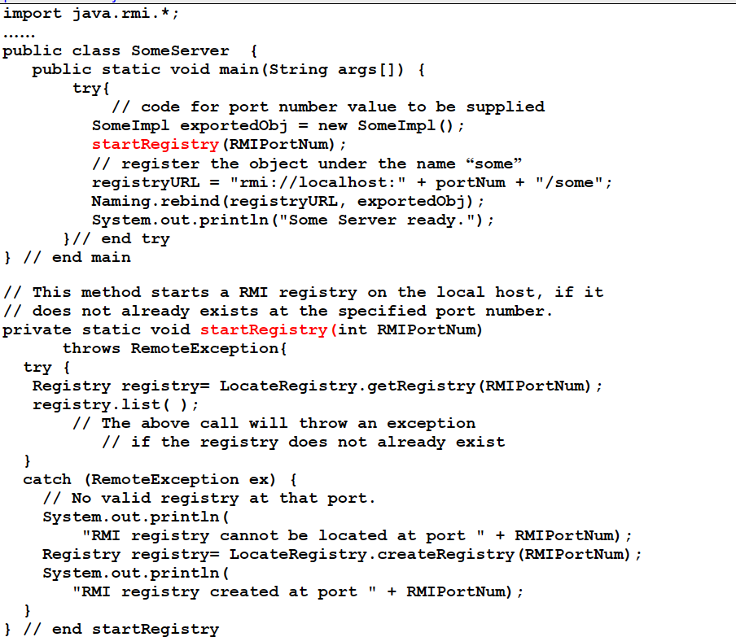
Notes:
The Object Server - 3
n In our object server template, the code for exporting an object is as follows:
// register the object under the name “some”
registryURL = "rmi://localhost:" + portNum + "/some";
Naming.rebind(registryURL, exportedObj);
n The Naming class provides methods for storing and obtaining references from the registry.
n In particular, the rebind method allow an object reference to be stored in the registry with a URL in the form of
rmi://<host name>:<port number>/<reference name>
n The rebind method will overwrite any reference in the registry bound with the given reference name.
n If the overwriting is not desirable, there is also a bind method.
n The host name should be the name of the server, or simply “localhost”.
n The reference name is a name of your choice, and should be unique in the registry.
The RMI Registry
n A server exports an object by registering it by a symbolic name with a server known as the RMI registry.
// Create an object of the Interface
SomeInterfacel obj = new SomeInterface(“Server1”);
// Register the object; rebind will overwirte existing
// registration by same name – bind( ) will not.
Naming.rebind(“Server1”, obj);
n A server, called the RMI Registry, is required to run on the host of the server which exports remote objects.
n The RMIRegistry is a server located at port 1099 by default
n It can be invoked dynamically in the server class:
import java.rmi.registry.LocateRegistry;
…
LocateRegistry.createRegistry ( 1099 );…
The RMI Registry - 2
n Alternatively, an RMI registry can be activated by hand using the rmiregistry utility :
rmiregistry <port number>
where the port number is a TCP port number.
n If no port number is specified, port number 1099 is assumed.
n The registry will run continuously until it is shut down (via CTRL-C, for example)
The Object Server - 5
n When an object server is executed, the exporting of the distributed object causes the server process to begin to listen and wait for clients to connect and request the service of the object.
n An RMI object server is a concurrent server: each request from an object client is serviced using a separate thread of the server.
n Note that if a client process invokes multiple remote method calls, these calls will be executed concurrently unless provisions are made in the client process to synchronize the calls.

Slide 27
The Client-side Software
The program for the client class is like any other Java class.
The syntax needed for RMI involves
locating the RMI Registry in the server host,and
looking up the remote reference for the server object; the reference can then be cast to the remote interface class and the remote methods invoked.

Slide 28
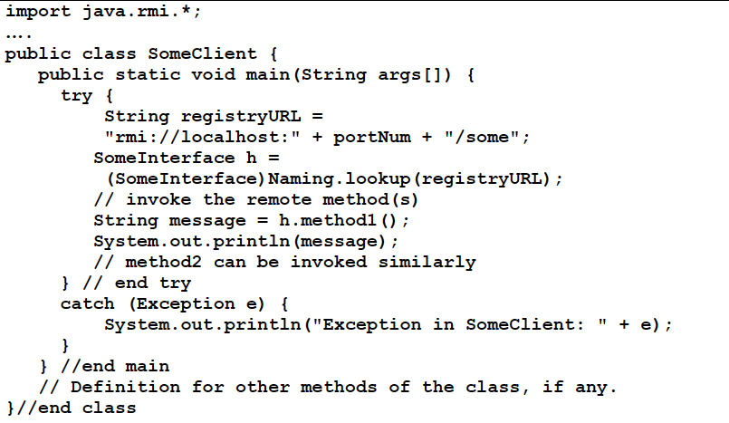

Slide 29
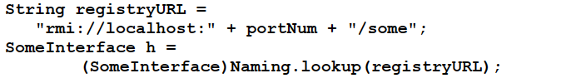
The Client-side Software
Looking up the remote object
The lookup method of the Naming class is used to retrieve the object reference, if any, previously stored in the registry by the object server. Note that the retrieved reference must be cast to the remote interface (not its implementation) class.
Invoking the Remote Method
The remote interface reference can be used to invoke any of the methods in the remote interface, as in the example:
String message = h.method1();
System.out.println(message);
Note that the syntax for the invocation of the remote methods is the same as for local methods.
It is a common mistake to cast the object retrieved from the registry to the interface implementation class or the server object class .
Instead, it should be cast as the interface class.

